Slide 1

Differentially Private Naïve Bayes Classification By Jaideep Vaidya, Anirban Basu, Basit Shafiq, Yuan Hong
IE – 506 COURSE PROJECT
endterm review
Submitted By :
Team Name: Sigma Enigma
Saurabh Kumar Khandelwal (22M0574)
Samagra Vijaywargiya (22M0570)
Submitted To :
PROF. P Balamurugan
IEOR, IIT BOMBAY

Slide 2
OUTLINE
Introduction
Summary of the Work Done before Mid-Term Review
Major Comments during Mid-Term Review
Addressal of Comments
Work Done after Mid-Term Review
Experiments Replicated
Conclusion
Future Work possibilities
References

Slide 3
INTRODUCTION
The main focus of this project is to implement a differentially private naïve bayes classification algorithm with reasonable accuracy and privacy.
Differential privacy ensures that the removal or addition of a single item from the database does not (substantially) affect the outcome of any analysis.
Naïve Bayes is a very effective classifier and is often used as a baseline classifier despite its simplicity. It takes an arbitrary number of continuous or categorical variables and classifies an instance to belong to one of several classes.
The main task was to add some appropriate noise (acc to laplace distribution) to the attributes data used to find the probabilities which are then used to predict the class of a particular instance.
The noise is added to the no. of counts for categorical attributes whereas in the case of numeric attributes, the mean and standard deviation are adjusted with the noise to get the updated probabilities which can be used to find the class as per Naïve Bayes Classification.

Slide 4
Summary of the Work Done before Mid-Term Review
Understanding the basic concepts of differential privacy and the Naïve bayes classification and the literature review of major works done in the last two decades was done along with a thorough study of the paper.
The mathematical background involving the topic, like formulas, theorems and properties that are used in implementing the algorithm.
Basic outline of the code was discussed which was then worked upon after the mid-term.
A modification to the current work was also proposed.

Slide 5
Major comments during Mid-Term Review
Implementation of the code for a differentially private naïve bayes classifier with the help of the algorithm given in the paper.
Apply the modification proposed by the team to the current work.
Check if the classification model still gives reasonable accuracy to unseen data after applying the privacy.
It was asked to not use sklearn library for the differential privacy, instead it was advised to write the code for the algorithm step by step.

Slide 6
Addressal of Comments
We’ve implemented the algorithm for the differential private naïve bayes classification for both categorical and numerical attributes.
The code is run for different datasets used in the original paper and the comparison is made between the two.
No predefined library has been used in applying the privacy to the classification model in the code.
The accuracy of the model after adding the noise is discussed and the variation of the accuracy for different values of the privacy parameter Є is also noticed.

Slide 7
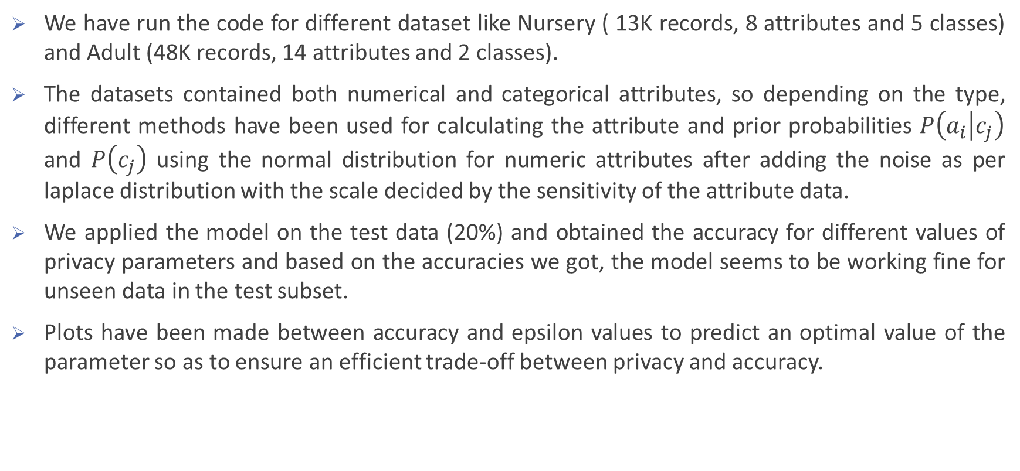
Work Done after Mid-Term Review
We have run the code for different dataset like Nursery ( 13K records, 8 attributes and 5 classes) and Adult (48K records, 14 attributes and 2 classes).
The datasets contained both numerical and categorical attributes, so depending on the type, different methods have been used for calculating the attribute and prior probabilities $P\left(a_{i} | c_{j}\right)$ and $P\left(c_{j}\right)$ using the normal distribution for numeric attributes after adding the noise as per laplace distribution with the scale decided by the sensitivity of the attribute data.
We applied the model on the test data (20%) and obtained the accuracy for different values of privacy parameters and based on the accuracies we got, the model seems to be working fine for unseen data in the test subset.
Plots have been made between accuracy and epsilon values to predict an optimal value of the parameter so as to ensure an efficient trade-off between privacy and accuracy.

Slide 8
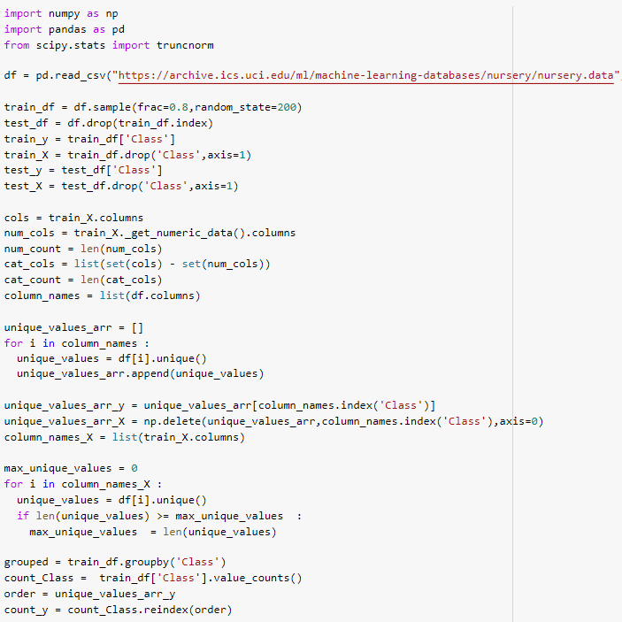

Slide 9
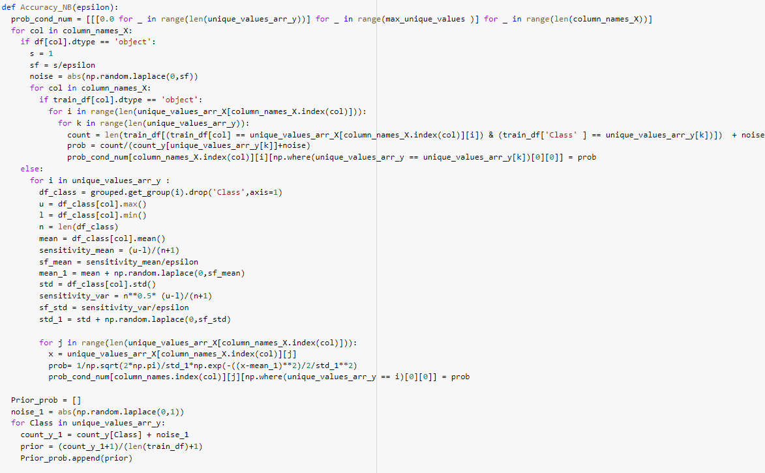

Slide 10
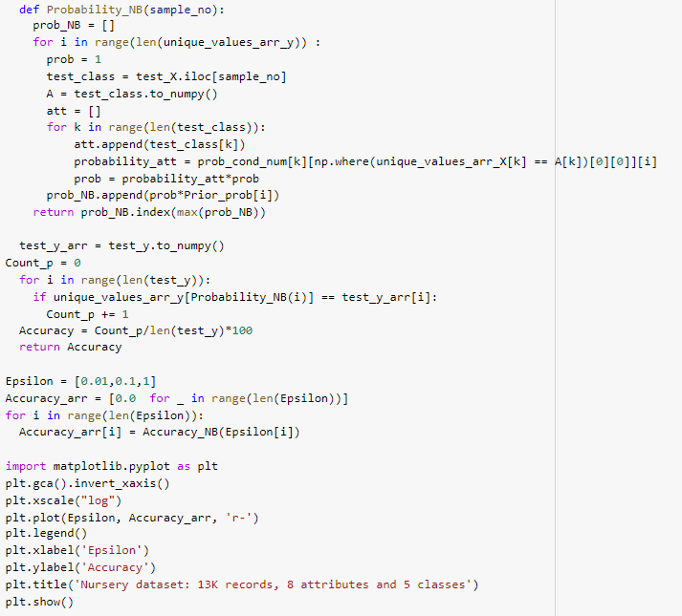

Slide 11
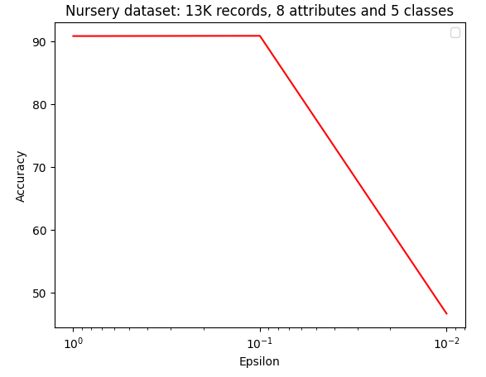
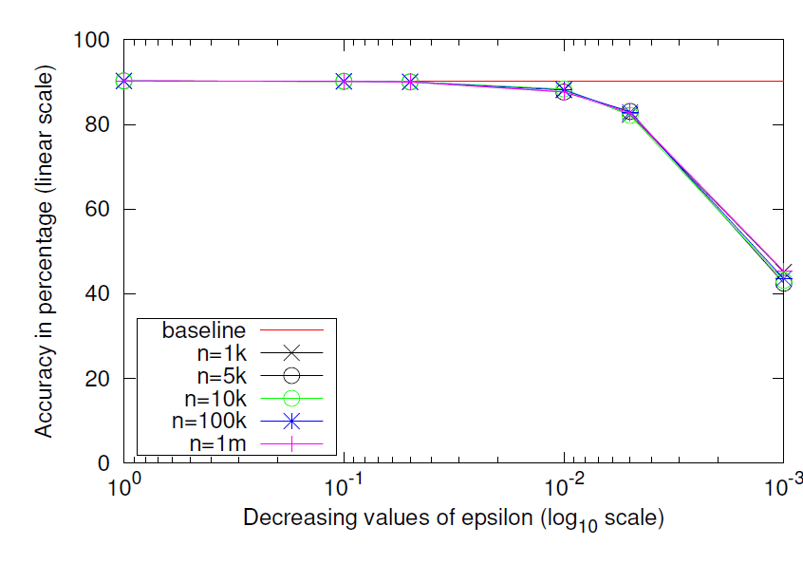
Experiments Replicated

Slide 12
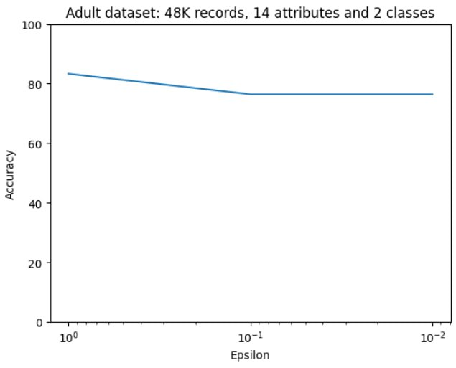
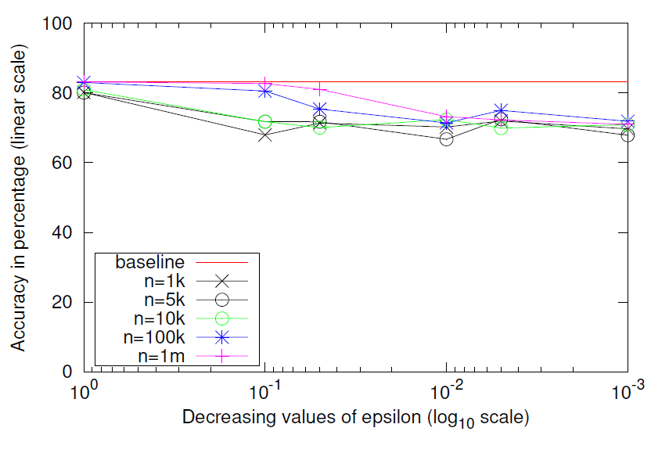

Slide 13
CONCLUSION
We have successfully implemented the code using the algorithm provided in the paper and have tested the model for different databases with varying no of samples, attributes and classes.
The accuracy in each case is calculated and found satisfactory in the range of 70 to 90% for adult dataset (for different values of Є) and 50-90% for the nursery dataset.
Three different values of the parameter Є has been chosen for determining the variation of accuracy and it has been found that the accuracy increases with increment of Є which confirms the trend as seen in the paper.
The code also runs with satisfactory result for datasets with mixed type of attributes i.e., both categorical and numeric.
Due to the random nature of the noise added to the attributes, the results changes with every run of the code but the value remains satisfactory.

Slide 14
Scope for future work
Instead of Naïve Bayes, other classification techniques can also be made differentially private.
Regression models can also be provided better privacy as in the case of continuous class, classification models do not work and regression analysis is used.
Other privacy-preserving techniques such as secure multi-party computation and homomorphic encryption can also be used.
The model can be made to work on even bigger datasets with millions of samples and attributes.

Slide 15
REFERENCES
[1] J. Vaidya, B. Shafiq, A. Basu, and Y. Hong, “Differentially private naive bayes classification,” in 2013 IEEE/WIC/ACM International Joint Conferences on Web Intelligence (WI) and Intelligent Agent Technologies (IAT), vol. 1, pp. 571– 576, IEEE, 2013.
[2] C. Dwork, F. McSherry, K. Nissim, and A. Smith, “Calibrating noise to sensitivity in private data analysis,” in TCC, 2006, pp. 265–284.
[3] Dwork, C. (2008). Differential Privacy: A Survey of Results. In: Agrawal, M., Du, D., Duan, Z., Li, A. (eds) Theory and Applications of Models of Computation. TAMC 2008. Lecture Notes in Computer Science, vol 4978. Springer, Berlin, Heidelberg. https://doi.org/10.1007/978-3-540-79228-4_1
[4] J. Vaidya, C. Clifton, and M. Zhu, Privacy-Preserving Data Mining, 1st ed., ser. Advances in Information Security. Springer-Verlag, 2005, vol. 19.
[5] Cynthia Dwork; Aaron Roth, The Algorithmic Foundations of Differential Privacy , now, 2014.

